Slide 1
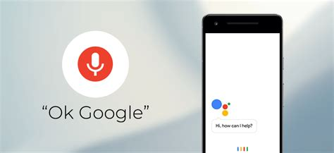

How do smart speakers work?
Vikranth Srivatsa

Slide 2
Background
3rd EECS student
Joined the Lab with Nathan start of 2020
Research and Data from the last year

Slide 3
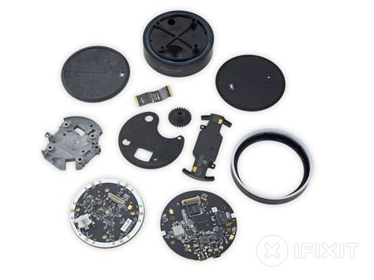
Intro/Why
Large parts of selling points of popular products
Commercial Systems aren’t open source so hard to research
Need to understand innerworkings to improve/break it
Concepts cover broad range of applications
Audio/File classification systems
Audio Processing
Audio to Text
Text Processing

Slide 4
General Pipeline
Audio Processing
Audio to
Text
Text Classification

Slide 5
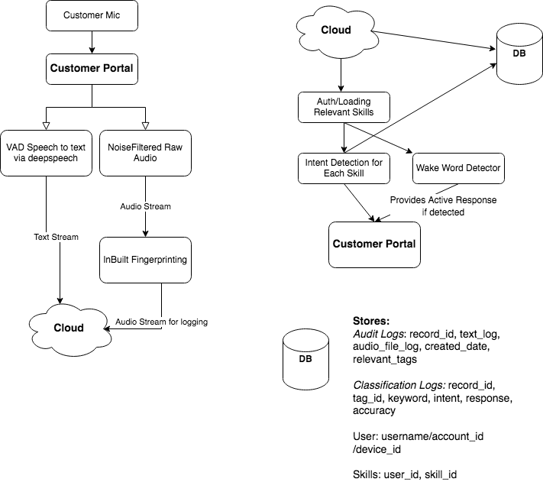
Example End to end Speech to Text system

Slide 6
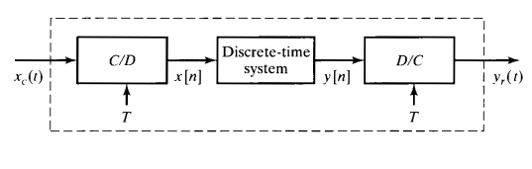
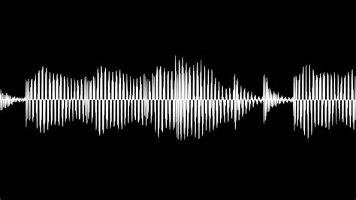
Audio Processing
Lots of Issues with Raw Audio
Digital Signal Processing Issues
Analog Signals get sampled at certain freq/rate
Improved via digital filters(Low Pass Filters)
Noisy Environment
Background noise
Bad mic
Improved via DSP techniques(Median Filter, gaussian noise reduction, etc.)
Popular python libraries to handle this
Multiple Speakers(Cocktail party problem)
Still a hard problem, recent attempts based on deep learning

Slide 7
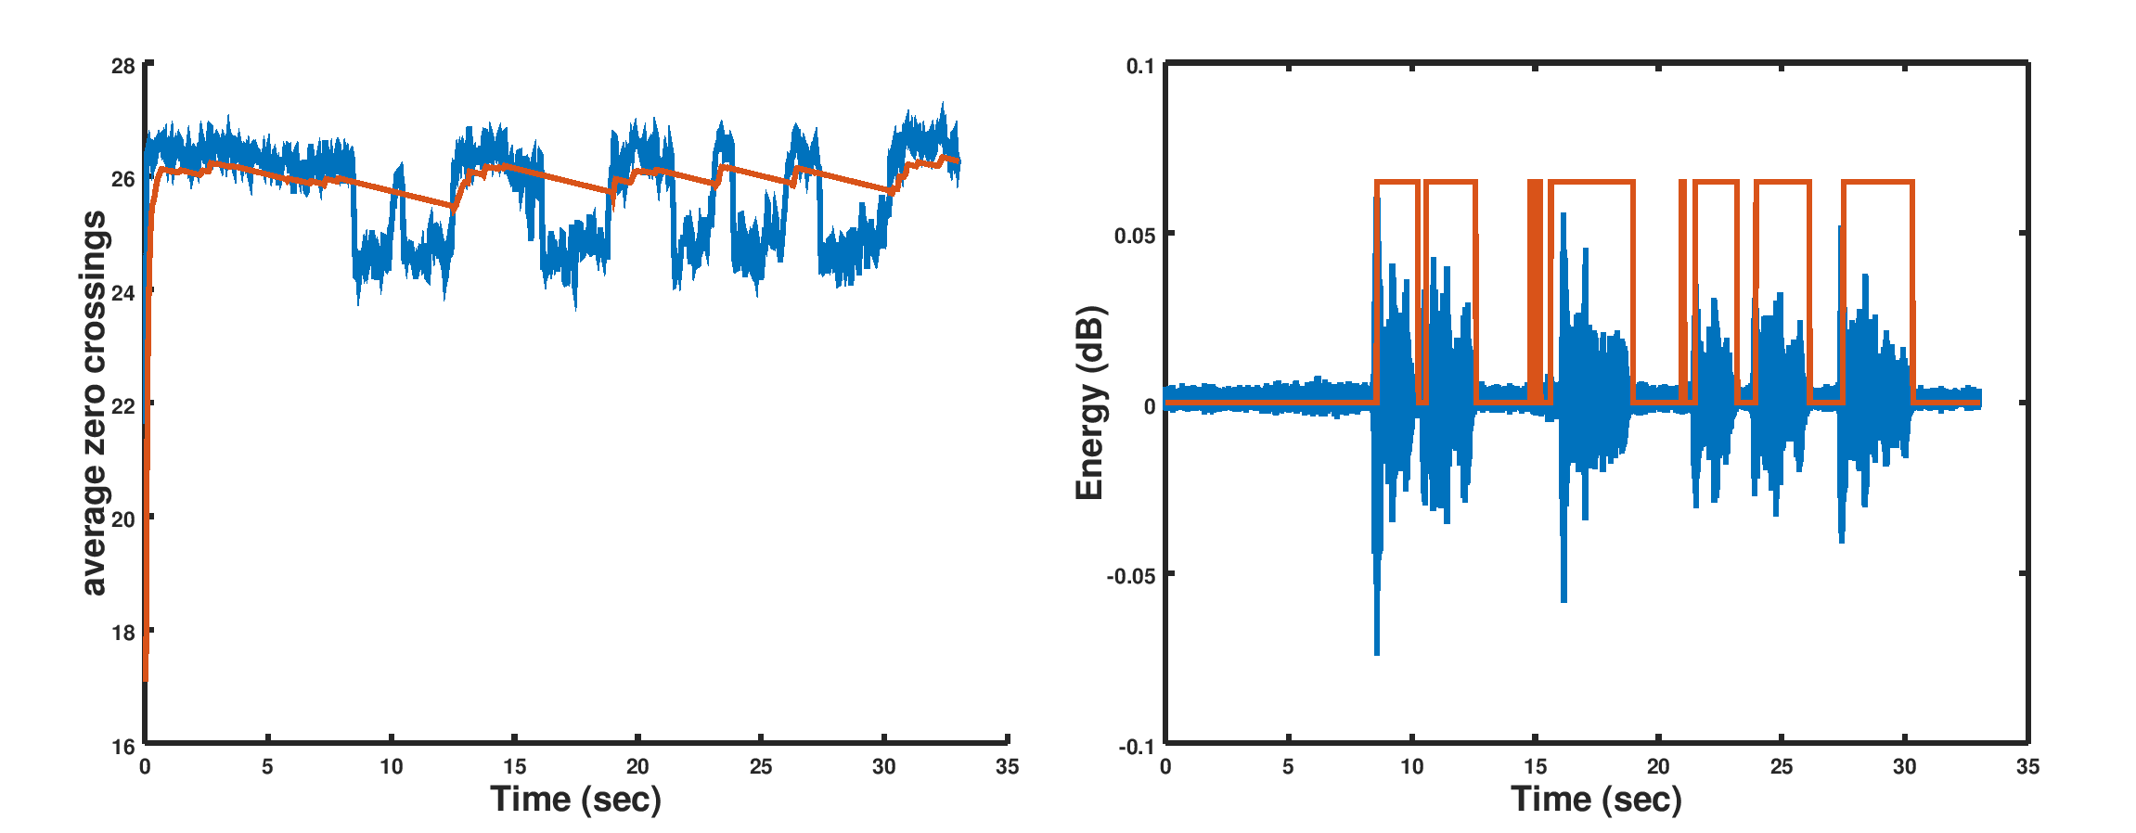
What audio do we care about?
Lots of audio signal
Wake word Detection
Audio Fingerprinting(Baby Crying/machine noise)
Detect via signal processing techniques
Peak detection from the spectrum
VAD Detection
Commonly used in many applications like discord
Energy of the audio signal to detect
Deep Learning (supervised classification)
Techniques with shape of audio signal

Slide 8
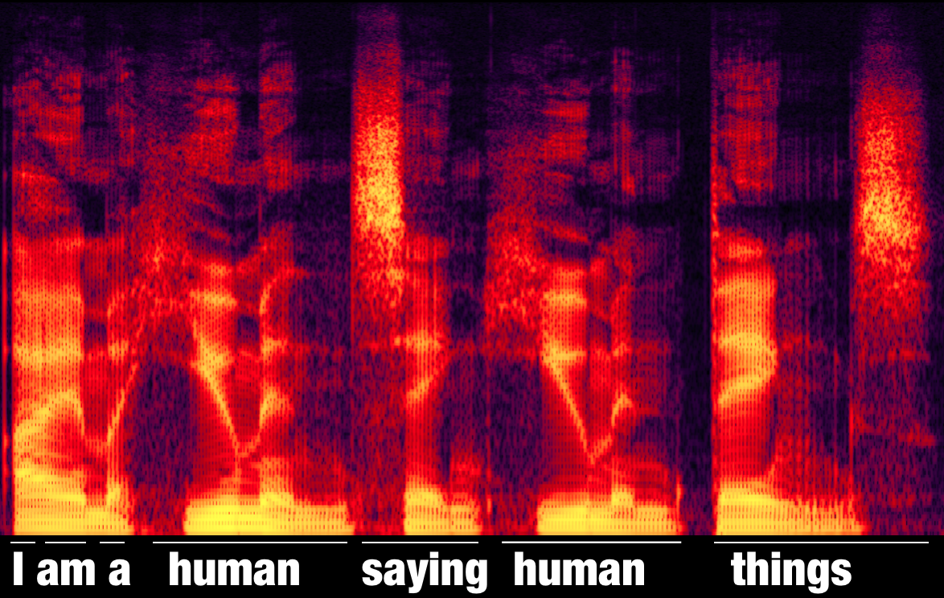
Audio to Text
Privacy concerns with commercial systems
Popular Open Source Options
Deepspeech
Wav2Letter
Training a RNN neural network on large datasets
Spectrograms of audio that translate to certain tagged sets
STFT/Wavelet transform can be used with these audio signals
LibSpeech/Common Voice Datasets used for training
Lot of text translation has a lot of error and is imperfect
Common source of error for classification pipelines
Decided to use Wav2letter for our current research

Slide 9
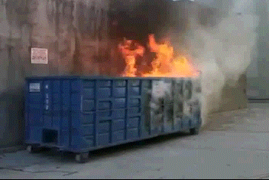
Speech to Text is still far from perfect
Example on faster speech
Original: “We ran out of toilet paper, paper towels, and hand sanitizer. I finished the chips last night. It looks we are almost out of sugar. I need to run to the store to get some fruits. I just ate the last apple”
Deepspeech: “of toliver he pretels them panseto sir i finished lotk for uss ony ololast night when we were washing lovie oks like we're al a tout of cigare ets a fruit i yu think lost appl”
Wav2Letter: “we are out out of to paper he tells from pan. i finished the box this morning .i ate all trips last night when you are washing will be it looks like we're almost on a figure i need your and the story and get some fruits just think the last apple we should get more milk said in a drinking”
Both work really well on clearer speech

Slide 10
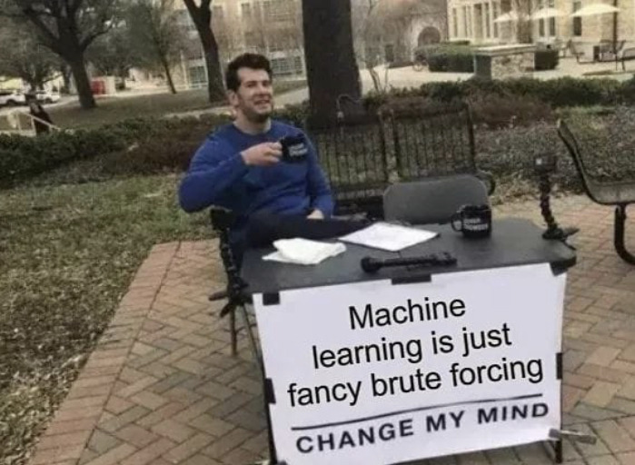
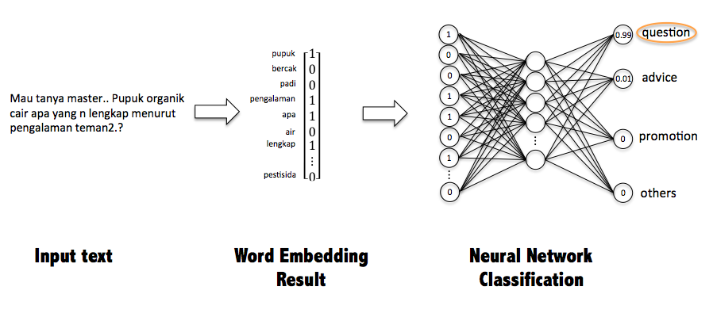
Text Processing/Classification:
Lot of information in text/hard to tell relevance
Need intent classification to process into relevant categories
Categories like weather/finance/shopping
NLP structure approach
Deep Learning app
Filter out irrelevant/out of scope(OOS) data

Slide 11
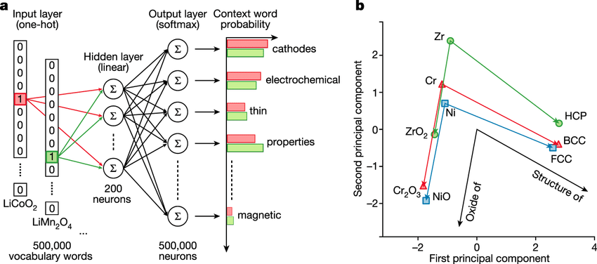
Training intent classifier
Encode text into vector space
“I ate an apple” -> [0.1623, .3174, .6312, .23411]
Distance in vector space represents meaning
Cosine similarity as a metric
Word Embeddings
word2vec(words closed together higher inner product)
GLoVe
Misses conceptual meanings
Sentence Embeddings
Run after running word embeddings + more contextual
Infersent(BI-LSTM) models
Bert
ELMo

Slide 12
Our training
Fairly easy to setup/replicate in terms of standard NN
GloVe/Infersent combo with 5 layer NN
To find the parameters, used grid search and common CNN practices
General Classifier(200 intents) receiving accuracy 90+
Categories such as Alarm/Shopping/Weather/Finance
We had a dataset of 10000 entries with training time of 6-7 hours
Specific Classifiers(Shopping)
Useful for keeping track of reminders to buy
“We ran out of eggs last week” would automatically add “eggs” to the shopping list
Combined with NLP approaches

Slide 13
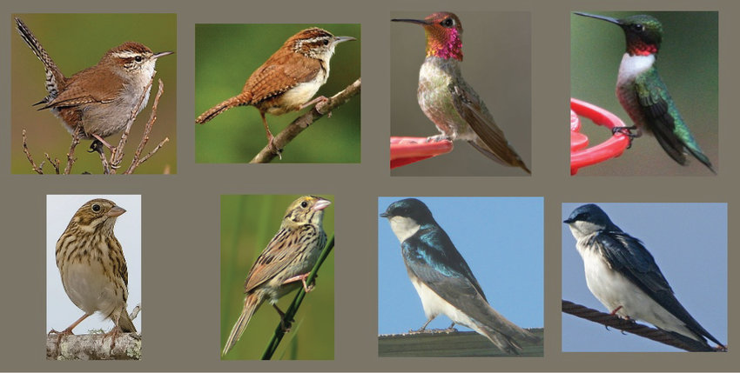
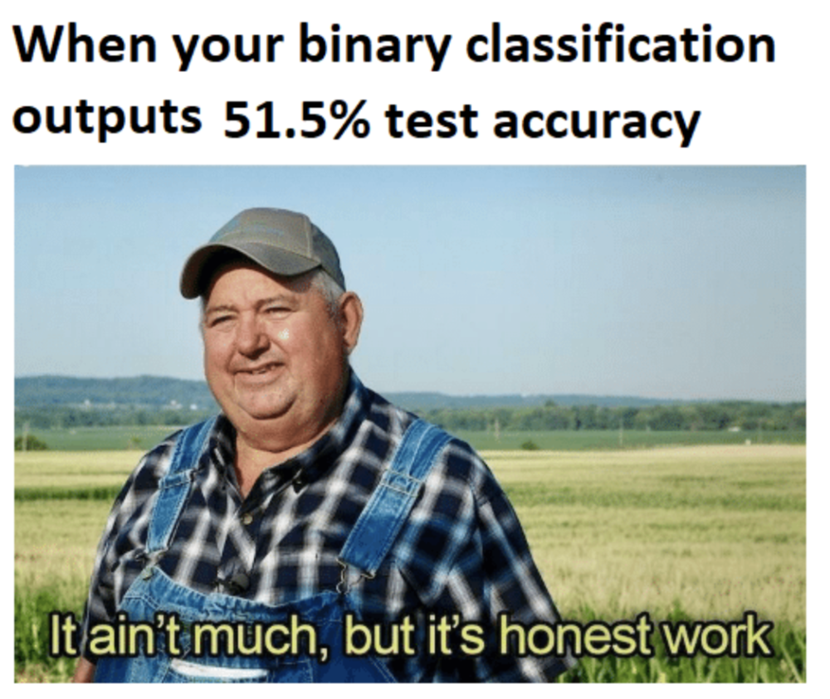
Intent Classification Issues
Dataset size too small?
Writing text by hand for categories is hard
Resampling/Cutmix/Contrastive Learning
Handle the case where none of the intent are valid?
Create large category with OOS data with book/conversation text
How do we verify accuracy of dataset?
Collected Big Brother dataset last year using scraper

Slide 14
More Intent Classification Issues
Many issues we can’t support or handle
How to prevent overfitting?
Ensemble learning used(combine multiple models)
Create many different kinds of deep learning models
How to handle multi-language classification?
Many people use transfer learning with complex models
How do we speed up training new intents/labeling?
Multi-label self learning systems via Bayesian synthetic data
How do we make classification very fast?
Real Time operating system support with very tiny models
Custom hardware is also very popular for this

Slide 15
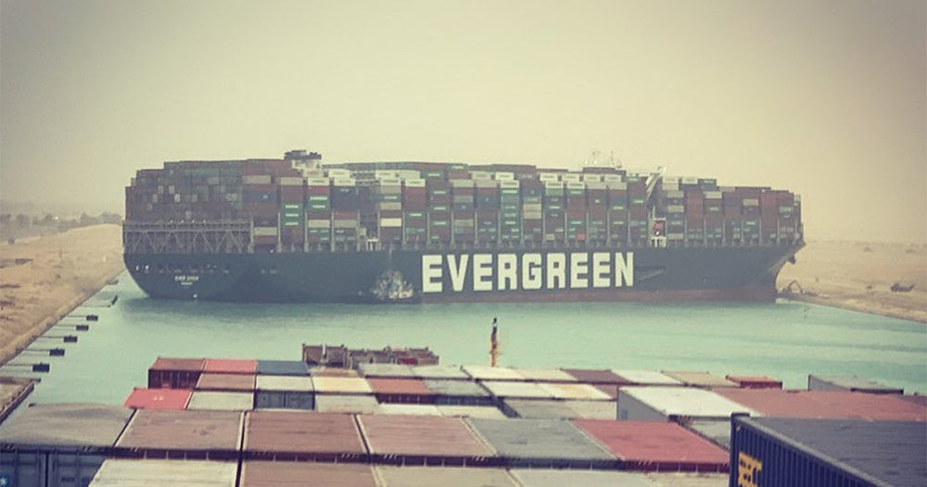
Current Work
How do we handle audio datasets when no specific wake word?
Hard problem in NLP
Rolling Windows(NLP analysis of datasets)
How much data should we store?
Current App
Weather system that uses passive context of previous conversations to find weather in location
Issues such as mentioning many destinations and using nouns that aren’t actual entities

Slide 16
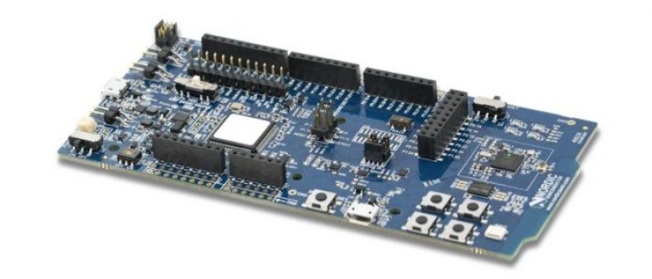

Extra: Performance Constraints
How to make code go really fast?
Models/Encoding can get very large especially on PI
Quantizing a model(convert 8bit while training)
Read more: https://arxiv.org/pdf/1712.05877.pdf
Distil(bert) models
Smaller model trained to provide equivalent performance
TinyML(Custom accelerators)
Constrained power + memory
Future of small devices
Current work: benchmarking with gemini + BOOM with small ml models
https://www.tinyml.org/

Slide 17
Conclusion
Systems may have many sources of error along the pipeline
Audio processing can be effective classification
Intent Classification can be used with small sets of text samples classify well
Overfitting/oversampling/OOS
Audio Processing
Audio to
Text
Text Classification

Slide 18
DEMO

